Slide 1

NYC Taxi Trip Time Prediction
Supervised Machine Learning Regression Model
LAKSHMI KEERTHANA
TITO VARGHESE

Slide 2
Problem Statement
Data Summary
Data Cleaning
Feature Engineering
Exploratory Data Analysis
Feature Selection
Model Building
Comparing Different Models
Evaluation Metrics
HyperParameter Tuning
Conclusion
Challenges
M/L Pipeline / Points to Discuss

Slide 3
Problem Statement
To clean,extract,analyse and to build a regression model based on the 2016 NYC yellow cab data set given to us-
The data was originally published by the NYC Taxi and Limousine Commission (TLC). The data was sampled and cleaned for the purposes of this project. Based on individual trip attributes, you should predict the duration of each trip in the test set.
NYC Taxi Data.csv - the training set (contains 1458644 trip records/rows)
NYC Taxi Data.csv - the training set (contains 11 features/columns)
'Pickup_longitude'
'pickup_latitude' 'dropoff_longitude' 'dropoff_latitude'
'store_and_fwd_flag'
Independent Features
Target Variable/Feature
‘trip_duration’
(It’s a continuous variable hence we will use a regression model)
'id'
'vendor_id'
'pickup_datetime'
'dropoff_datetime'
'passenger_count'

Slide 4

Data Summary
The dataset info gives us some crucial insights into our Features data type and Non Null Count:
RangeIndex: 1458644 entries, 0 to 1458643
Data columns (total 11 columns):
# Column Non-Null Count Dtype
--- ------ -------------- -----
0 id 1458644 non-null object
1 vendor_id 1458644 non-null int64
2 pickup_datetime 1458644 non-null object
3 dropoff_datetime 1458644 non-null object
4 passenger_count 1458644 non-null int64
5 pickup_longitude 1458644 non-null float64
6 pickup_latitude 1458644 non-null float64
7 dropoff_longitude 1458644 non-null float64
8 dropoff_latitude 1458644 non-null float64
9 store_and_fwd_flag 1458644 non-null object
10 trip_duration 1458644 non-null int64
dtypes: float64(4), int64(3), object(4)
Converted the datatype of pickup_date_time and dropoff_date_time to datetime datatype
df['pickup_datetime']=
pd.to_datetime(df['pickup_datetime'])
df['dropoff_datetime']= pd.to_datetime(df['dropoff_datetime'])

Slide 5
Data Cleaning
Data Cleaning is a crucial step before EDA as it will remove the ambiguous data that can affect the outcome of Model Accuracy.
While cleaning data we performed the following steps:
1) Handling missing values- Since the data given to us was sampled and cleaned for the purposes of this project,it saved lot of our time.
2) Handling duplicate rows - We haven’t came across any duplicate records in this data set.
3) Handling Outliers - There were few outliers were found in distance,trip_duration ,trip_speed and Pickup latitude and longitude,we removed it successfully by keeping all the records within np.percentile 99.8 value and np.percentile 1 values.
4) Handling Irrelevant records - The passenger count values 0 and more than 6 were removed from the records.
The final shape of the dataset after cleaning the records (1373771,27)

Slide 6
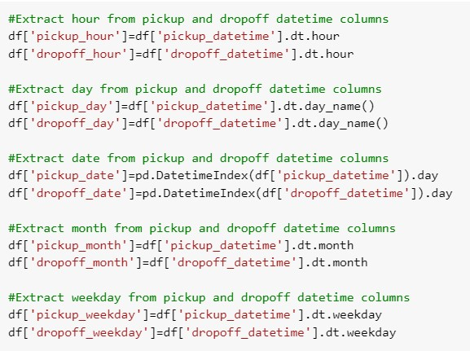
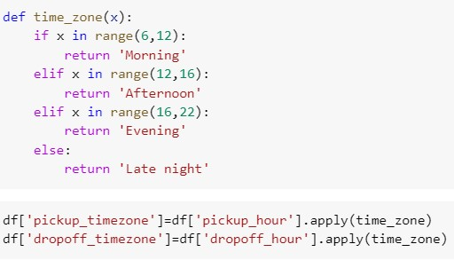
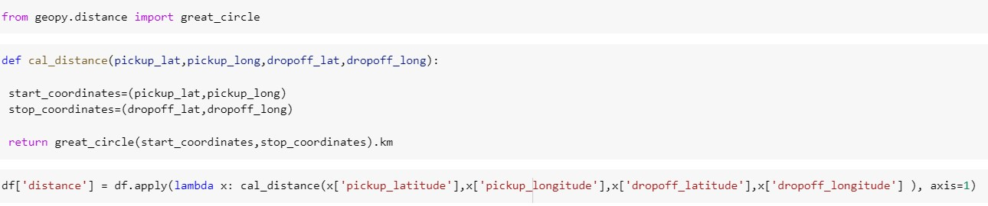
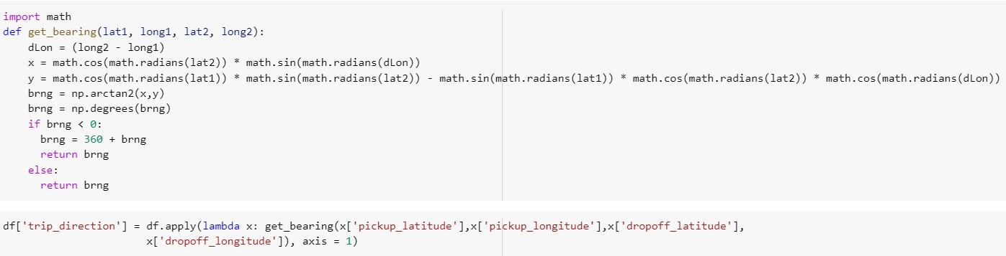
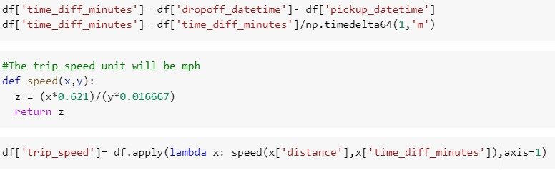
Feature Engineering
New Features Derived
We have derived few features from pickup/dropoff datetime columns after converting its datatype to datetime.
Few new features derived are-
pickup/dropoff month,day,weekday,hour,timezone and date.
We have derived 2 new feature (distance and trip_direction) using the geographical latitude and longitude features in our dataset.
We created another new features trip_speed using trip_distance(km) and trip_duration(seconds). We have used 0.621 to convert the trip distance to miles and 0.00278 to convert seconds to hour.

Slide 7
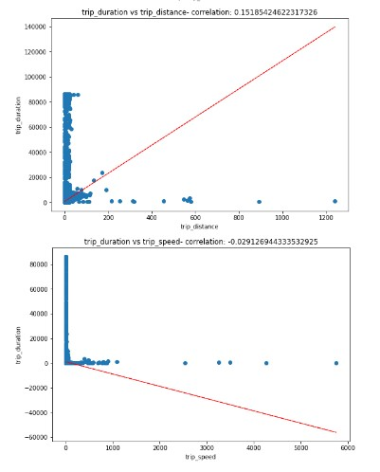

Feature Engineering
Checking for Linearity in Independant and Target Feature
Feature Encoding
Encoding leads to a better model and most algorithms cannot handle the categorical variables unless they are converted into a numerical value.
In this project we have used hot encoding techniques.
The distance shows a positive linear relationship with trip_duration
On the Other Hand, the trip_speed shows a negative linear relationship with trip_duration

Slide 8
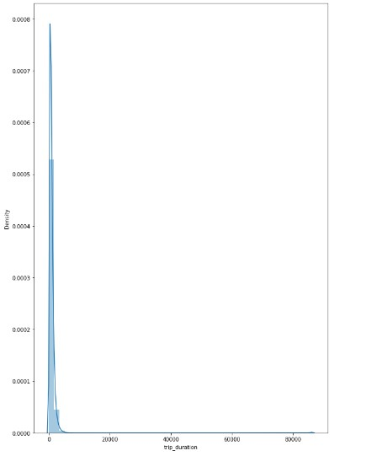
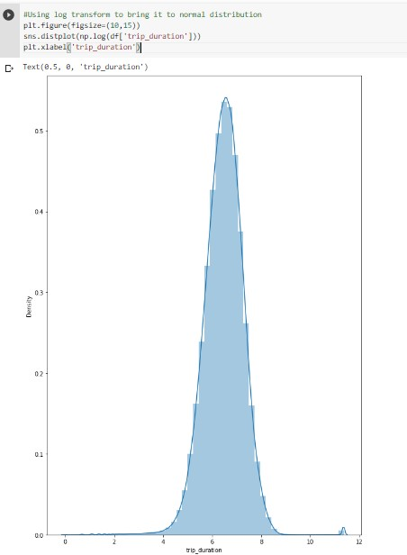
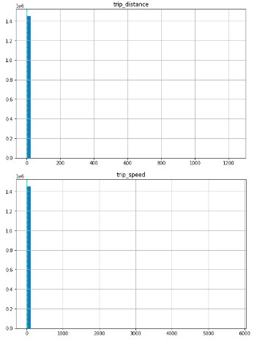
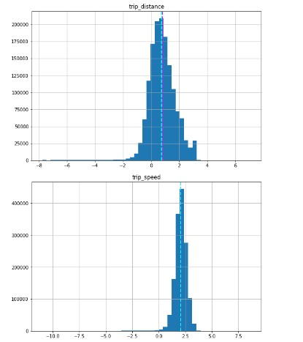
Feature Engineering
Handling Skewness in Features Distribution
We have used log transform to handle the skewness on the target variable ,distance features

Slide 9
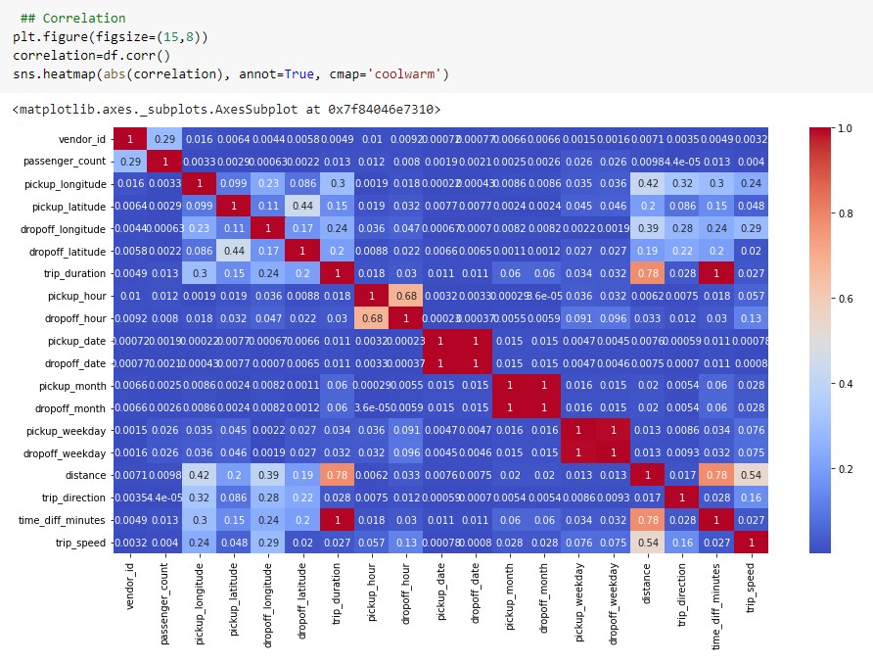
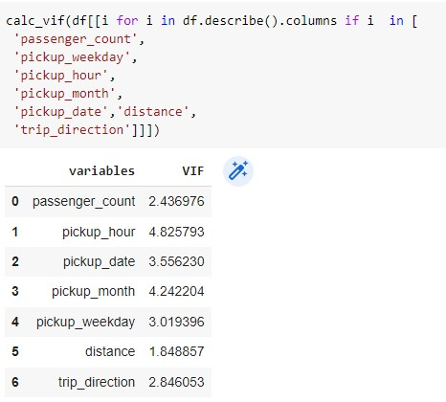
Multicollinearity
1. We can see a high correlation between pickup_month and dropoff_month,pickup_date and dropoff_date,pickup_weekday and dropoff_weekday.
2. Our target variable shows 0.78 percent correlation with distance.
3. pickup_hour and dropoff hour shows a correlation of 0.68.
4. We drop time_diff_minutes since its highly correlated with trip_duration.
5. In all highly correlated features we can only keep the pickup details and drop the drop off details to remove multicollinearity.

Slide 10
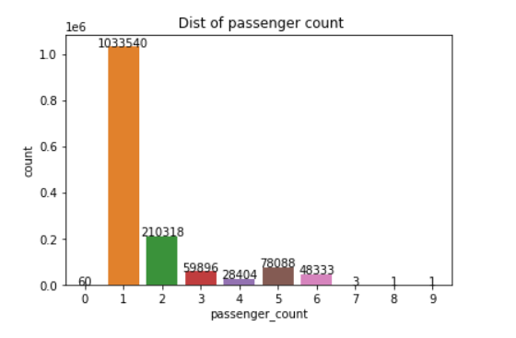
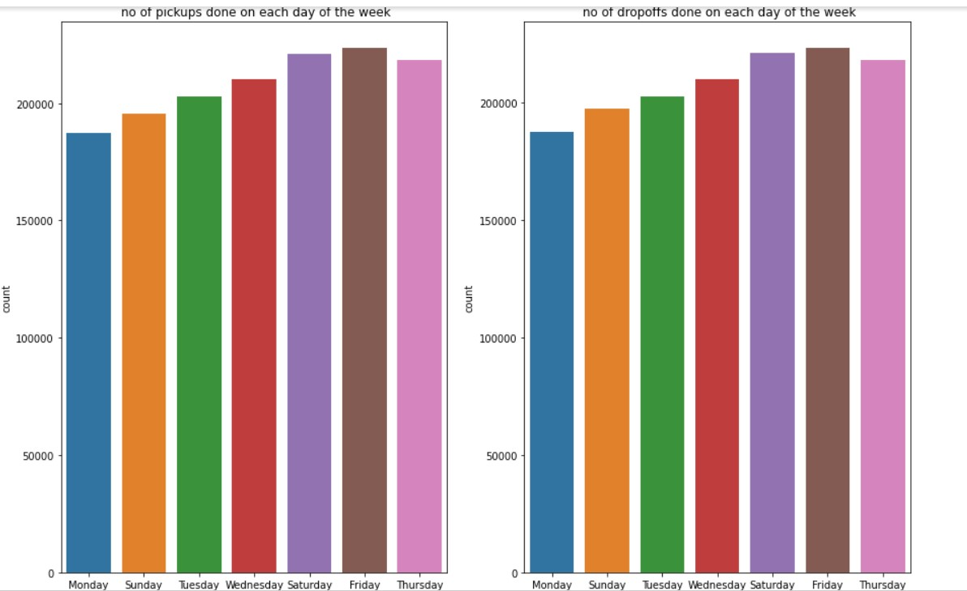
Exploratory Data Analysis (Univariate-Analysis)
The above plot tells us that the mostly the taxi trip passengers count is one.
It depicts that taxi are mostly prefered by those who likes to travel alone.
The plot tells us that mostly on friday's we can see a high demand for taxi trip and the least number of taxi trip demand on Monday.

Slide 11
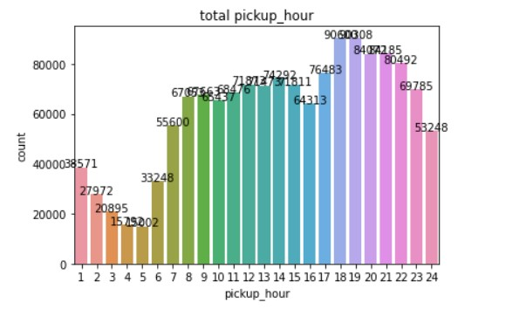
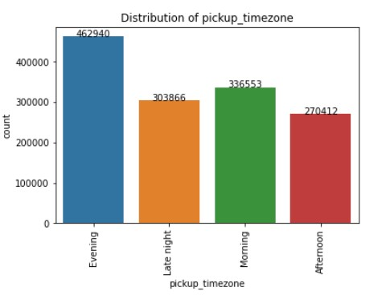
EDA (continued)
The most busy hours for taxi trip were between evening
18-22 hr.
The least busy hours were between early morning 2-5 hr.
The high demand for taxi trip is in the evening timezone.
The least demand for taxi trip is in the afternoon timezone

Slide 12
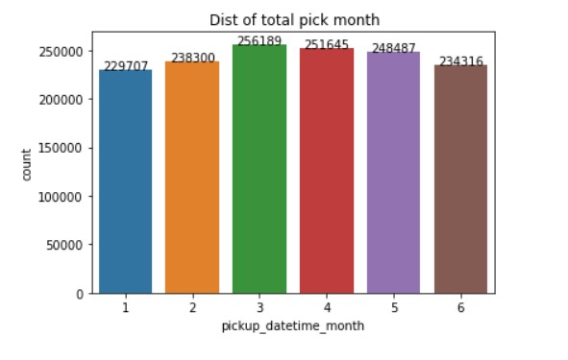
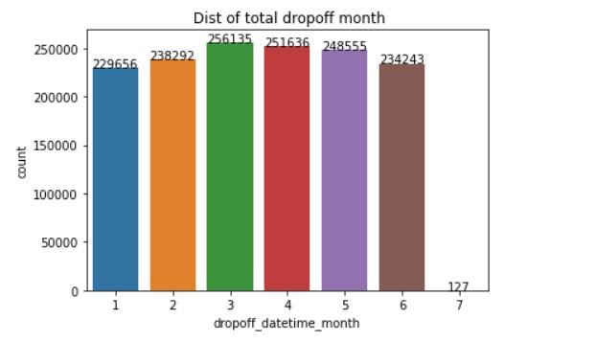
EDA (continued)
1.The month of March has received the highest number of trips followed by April for both pickup/dropoff.
2.The least number of trips done in the month of January and July.

Slide 13
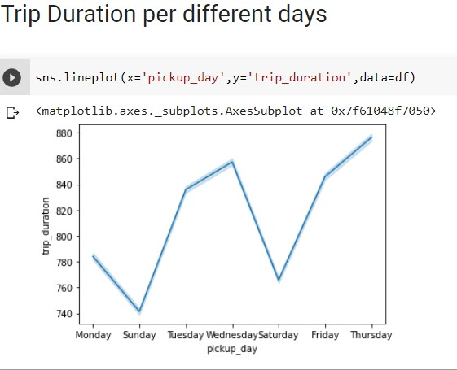
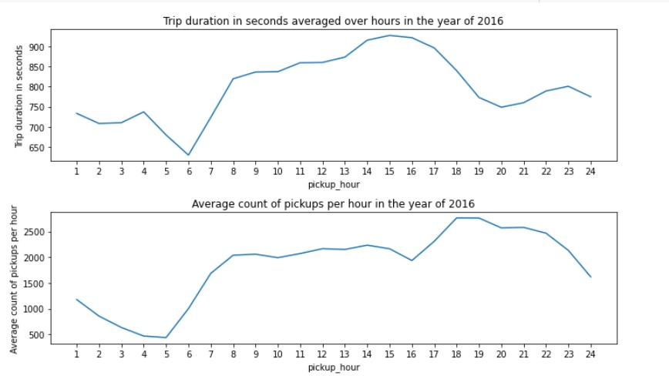
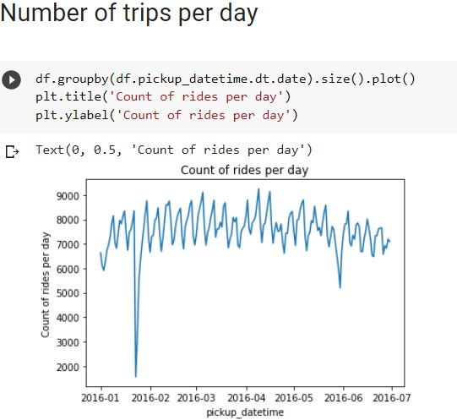
EDA (Bivariate Analysis)
Rides increase steadily from 5am to 8am only to flatten out between 8am to 4pm and then again steeply increase from 4pm to 6pm to fall down later.
The sudden dip in the taxi rides between the 20th and 26th Jan was because of the heavy snow that was observed during that period.
The trip duration is the maximum in Wednesday and lowest on Sunday

Slide 14
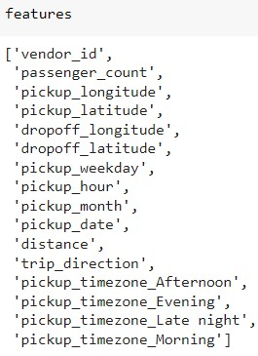
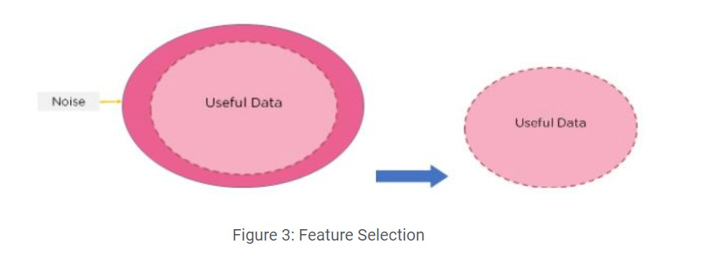
Feature Selection (Preparing dataset for modelling)
Feature Selection is the method of reducing the input variable to your model by using only relevant data and getting rid of noise in data.
To train an optimal model, we need to make sure that we use only the essential features. If we have too many features, the model can capture the unimportant patterns and learn from noise.
Train set - (1099016, 16)
Test set - (274755, 16)
Task - Regression Model

Slide 15
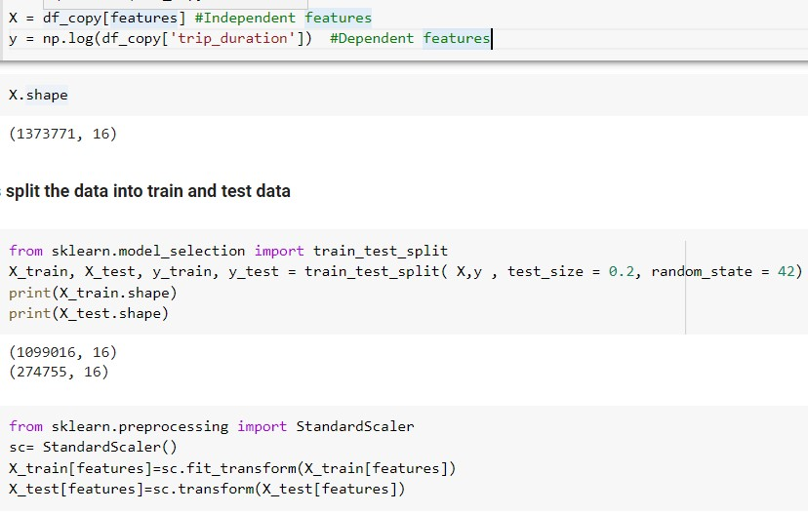
Model Building
The Initial Step for Model building will be to split the dataset into train and test data
Then,we have performed Standard Scaler scaling technique on the training set using fit.transform and thereafter transformed the test data .
If our data in any conditions has data points far from each other, scaling is a technique to make them closer to each other or in simpler words, we can say that the scaling is used for making data points generalized so that the distance between them will be lower.

Slide 16
Different Regression Machine Learning Algorithm/Models
The Regression Models which we were used-
1.Linear Regression Model (Simple/Base Model)
2. Lasso and Ridge Regularized Regression Models
3. Decision Tree Model
4. Random Forest (Ensemble Bagging Model)
5. Xgboost (Ensemble Boosting Model)
We have many variables such as the pickup/dropoff month, weekday, hour of the day, trip direction which are not linear variables and can be difficult for a linear regression (LR) algorithm to model without first converting these variables to appropriate forms that can be fed to the LR models
Another alternative is we can use non-linear methods such as decision trees to fit the data. Decision tree doesn’t require us to convert the variables because it can split across any values of the variables
But before moving onto decision trees or random forest let’s check the performance of LR using only few significant variables such as the distance, hour and weekday.

Slide 17
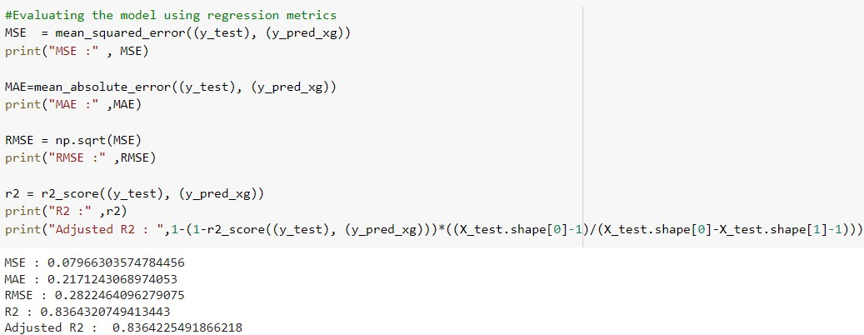
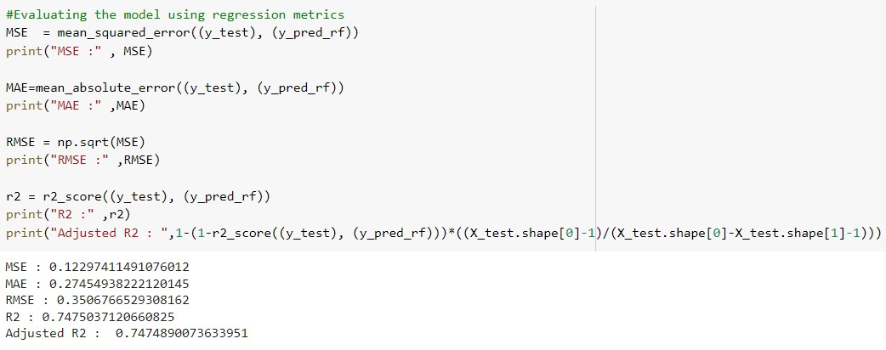
Evaluation Metrics
MAE is the easiest to understand, because it's the average error.
MSE is more popular than MAE, because MSE "punishes" larger errors, which tends to be useful in the real world.
RMSE is even more popular than MSE, because RMSE is interpretable in the "y" units.
All of these are loss functions, because we want to minimize them.
R-square(R²) is also known as the coefficient of determination, It is the proportion of variation in Y explained by the independent variables X. It is the measure of goodness of fit of the model.
Similar to R², the Adjusted R² measures the variation in the dependent variable.

Slide 18
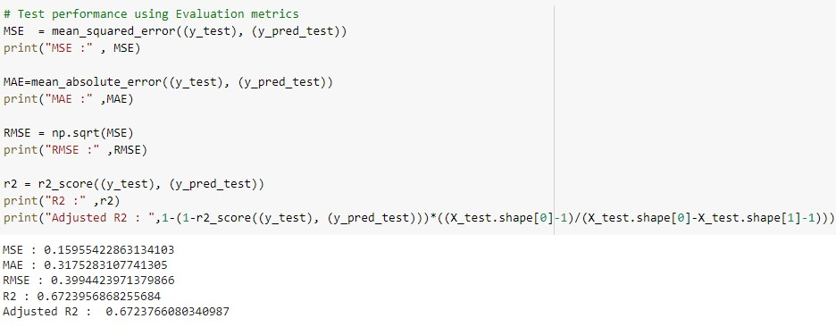
Applying Model (Baseline Model)
Linear Regression Model

Slide 19
Model Validation and Selection
S.No | Model Name | Train Accuracy | Test Accuracy | M.S.E | R.M.S.E | MAE | Adjusted r2 score
1 | Linear Regression | 0.67 | 0.67 | 0.160 | 0.399 | 0.317 | 0.67
2 | Ridge | 0.7 | 0.7 | 0.146 | 0.382 | 0.302 | 0.69
3 | Lasso | 0.69 | 0.69 | 0.147 | 0.383 | 0.303 | 0.69
4 | Decision Tree | 0.66 | 0.65 | 0.165 | 0.407 | 0.312 | 0.65
5 | Random Forest | 0.74 | 0.74 | 0.123 | 0.351 | 0.275 | 0.74
6 | Xgboost | 0.84 | 0.83 | 0.079 | 0.2822 | 0.217 | 0.83

Slide 20
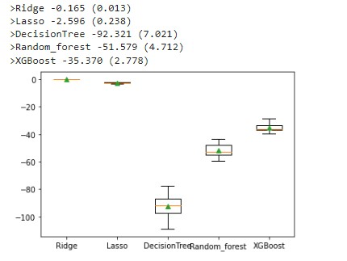
Model Validation and Selection
Based on negative mean square error metrics
We can say from looking at the boxplot that Ridge and Lasso Models were the Best Model.
The second best model is Xgboost model followed by Random Forest Model giving third least negative mean square error.
The Decision Tree Model has given the highest negative mean square error and hence underperformed model comparatively to other regression models.
Negative Mean Square Error (BoxPlot)

Slide 21
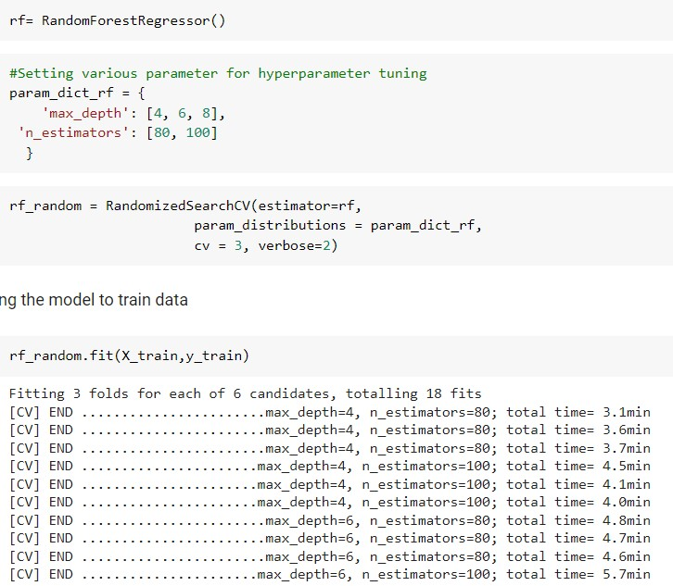
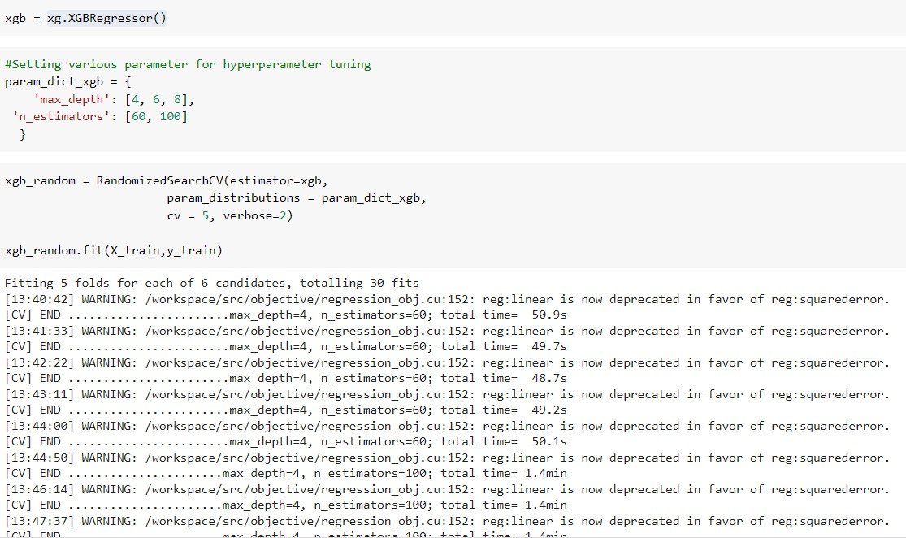
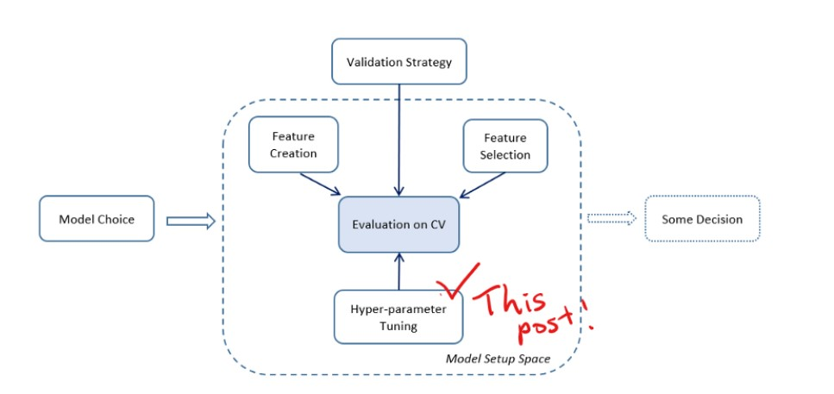
Hyperparameter tuning / Cross- Validation
We have already learned to use train_test_split to split the data, so you can measure model quality on the test data. Compared to train_test_split, cross-validation gives you a more reliable measure of your model's quality, though it takes longer to run.
Hyperparameter Tuning is a method to tune the parameters in a model to optimize the model & give a best accuracy score by selecting the best parameter using cross validation.
In this project,we have used Randomizedsearchcv for hyperparameter tuning,because its comparatively faster than GridSearchCV.

Slide 22
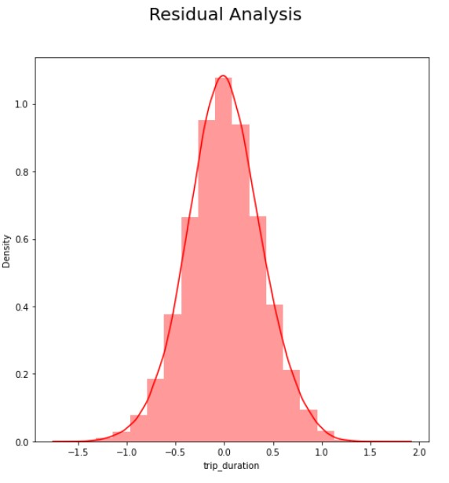
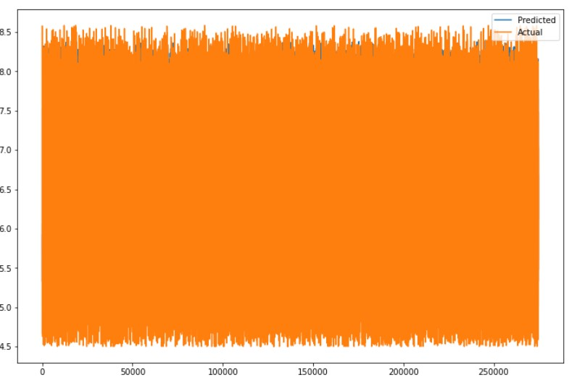
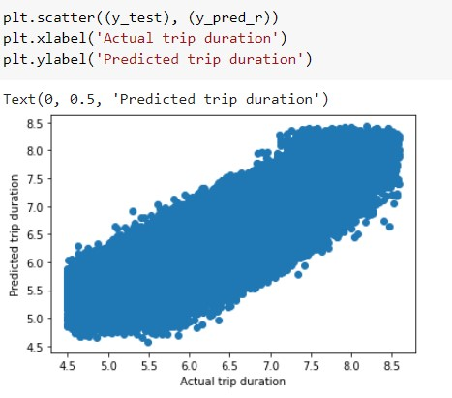
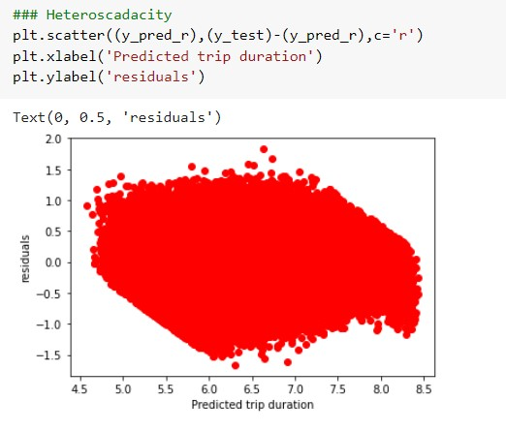
Scatter Plot / Residual Plot / Heteroscedasticity Plot

Slide 23
Conclusion
1.We can also use stacking algorithm over here to find the accuracy,but due to the high computation time we didn't used it.
2.We got the best model accuracy in Xgboost model,r2 score of 0.84 in training set and 0.83 in test data..The RMSE score of Xgboost model is 0.282
3.Our second best model is Random Forest based with a r2 score of 0.7485 accuracy in training and 0.7475 accuracy in test data. The RMSE score of random forest is 0.350
4.Our base model (Linear Regression) gave us a r2_score of 0.67 in train and test data and keep this model accuracy in reference to compare other model.
5.Decision Tree has given us least score in evaluation compared to all other algorithms based on negative mean absolute error.
6.We just used ensemble techniques over here to demonstrate various other options for these kind of regression problems
7.We can also do Model Explainability of random forest and Xgboost model over here using SHAP or LIME

Slide 24
Challenges
Extracting new features from existing features were a bit tedious job to do.
Handling Outliers in Independent features was bit lengthy process.
There were few irrelevant data records present in the dataset.
The Randomised Search cv took nearly more than a hour to run ,so it was really time consuming task.

Slide 25
Thank You!!!

